Slide 1
Trends in Gross Electricity and Derived Heat Production in the European Union (EU-27) by Type of Fuel, 1990–2024
MAYO, JONATHAN LANCE
NARAGA, DARVEN ROSS
VILLEGAS, ALLYZA FE

Slide 2
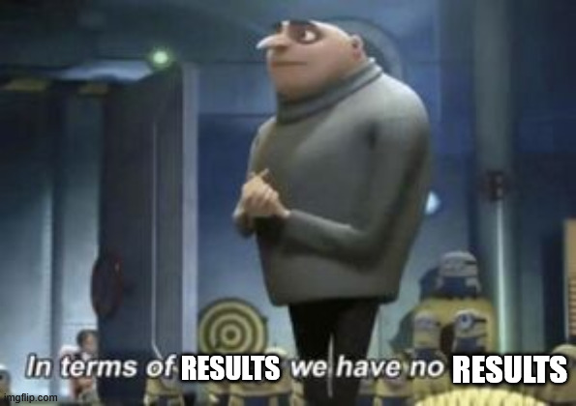
RESULTS AND DISCUSSIONS

Slide 3

RESULTS AND DISCUSSIONS
IS THE FRAMEWORK FEASIBLY?
-STAKEHOLDERS

Slide 4

RESULTS AND DISCUSSIONS

Slide 5

RESULTS AND DISCUSSIONS

Slide 6

CONCLUSION

Slide 7

RECOMMENDATIONS

